Slide 1


Basic knowledge of TA Frameworks

Slide 2
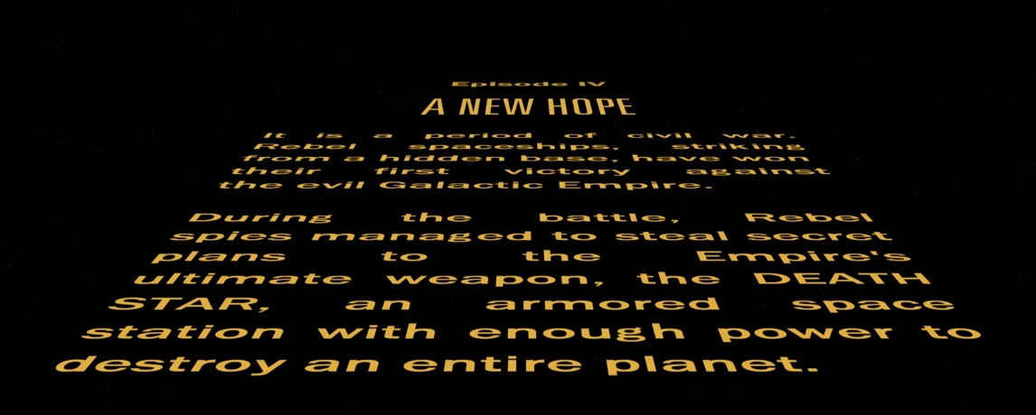
Basic knowledge of TA Frameworks
1
What is Framework?
2
Do we need architecture?
3
How to start your own TA Framework
4
Configuration of TA Framework
5
Main layers of TA Framework

Slide 3

What Is Framework?
Framework – architectural solution which defines program structure
TA Framework – structure and modules which gives ability to test application
TA Framework Architecture – modules, configuration, layers and their interaction
Notes:
P37 – divide into 2 slides

Slide 4


We don’t need architecture
Is it true ?
I don’t think so
Notes:
P37 – divide into 2 slides

Slide 5
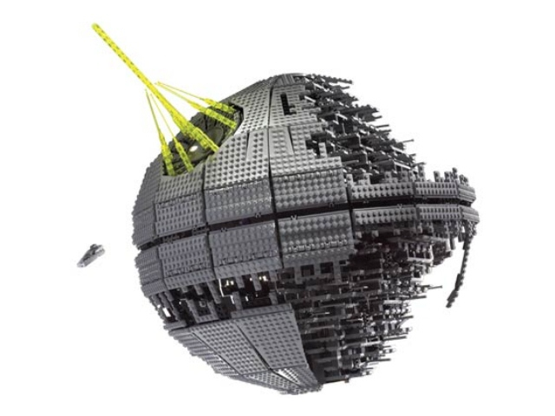


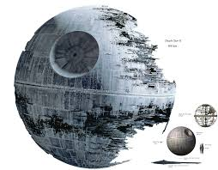

How to start
Create demo version
Research application
Define configuration
Start development
Get approve
Notes:
P37 – divide into 2 slides

Slide 6
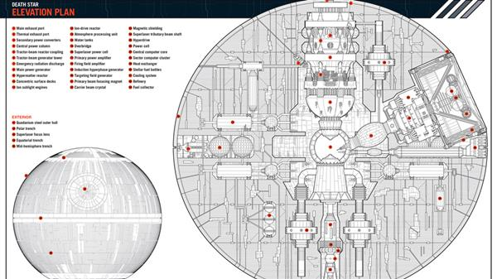
Configuration of Test Automation Framework
Strategy – define what type of tests will be executed
Modules – define main stack of necessary modules to make monolith structure
Parameters – define variable parameters to work with different environments, browsers etc.
Layers – define layers which is necessary for pretty architecture building
External systems – define systems, our framework should be integrated with (VCS, CI etc.)
Notes:
P37 – divide into 2 slides

Slide 7
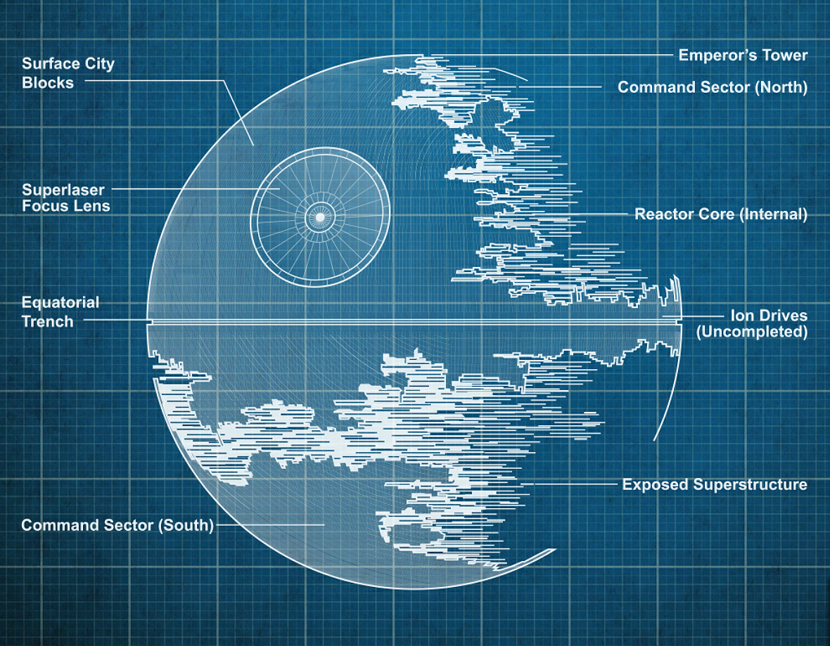
Main layers of Test Automation Framework
Layers
Configuration layer
runner
data
Business layer
business structure
services
Test layer
tests
hooks
Notes:
P37 – divide into 2 slides

Slide 8




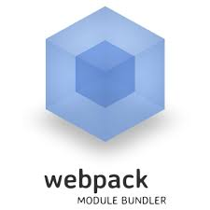

Task runner
Task runners
Notes:
P37 – divide into 2 slides

Slide 9


Configuration layer
Driver set up
Config
Files with additional parameters
Capabilities
Data
Any other if you need it
Be careful with configuration
Notes:
P37 – divide into 2 slides

Slide 10

Business layer
Page objects
Other business objects
Services
Helpers
Extensions
Factories
Notes:
P37 – divide into 2 slides

Slide 11
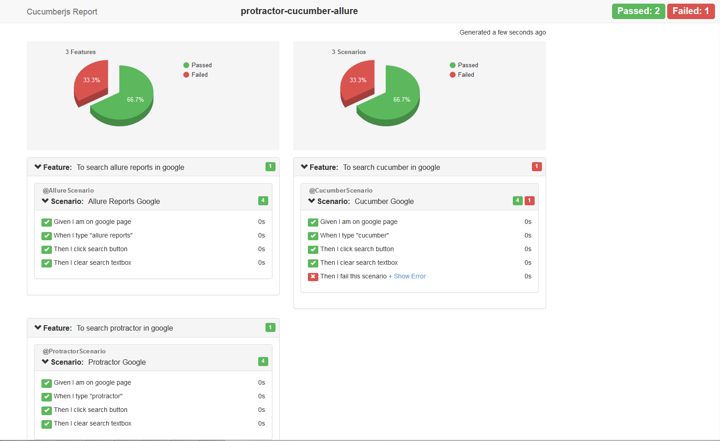
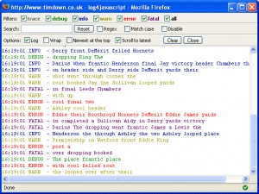

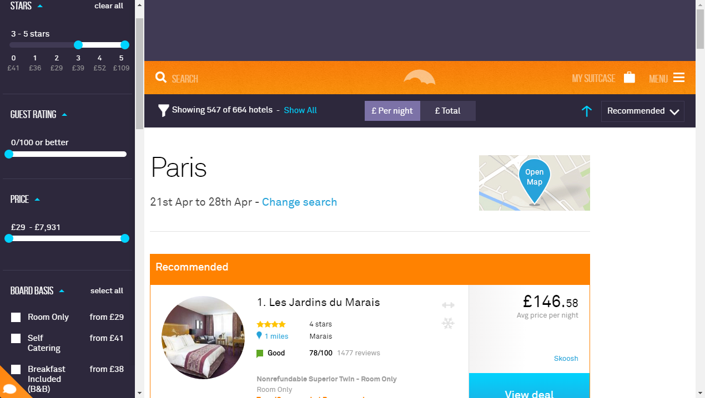
Logs and reports
Reports
Logs
Screenshots
Functionality for them
If customer doesn’t like report
Notes:
P37 – divide into 2 slides

Slide 12

Tests’ layer
The main goal
Cucumber: features, step definitions
Jasmine: test files
Note: keep expectations in test layer
Notes:
P37 – divide into 2 slides

Slide 13

Training materials
Useful links
https://www.joecolantonio.com/2016/06/14/top-8-essential-javascript-automation-frameworks/
https://jasmine.github.io/
http://www.protractortest.org/#/
Code base
https://github.com/Ivan-Katovich/cms-protractor-fw
https://github.com/Ivan-Katovich/protractor-jasmin-fw
https://github.com/Ivan-Katovich/webdriver-js-fw
Notes:
P37 – divide into 2 slides

